Slide 1
The Ames Housing Dataset: Predicting House Prices with Linear Regression
Jocelyn Lutes
July 10, 2020
General Assembly DSI: Project 2

Slide 2
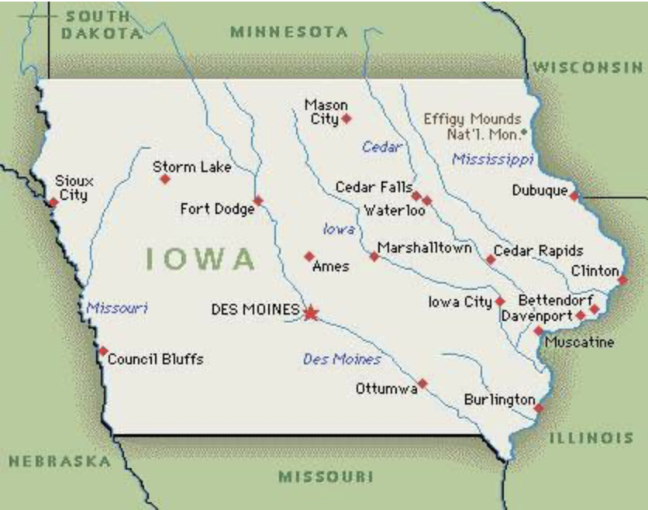
Ames Realty Co.
Source
As a newly hired member of the data science team, I will build a model that best predicts sales price for properties in Ames.

Slide 3
Work Flow
Step | Description
1. Obtain Data | Ames Housing Data (80 features, 2006-2010)
2. Clean Data | Null Values, Data Types, Values within expected range
3. Exploratory Data Analysis | Focus on relationship between features and target (Sale Price)
4. Feature Engineering | Informed by EDA
5. Model Preparation | Test Size = 20%
6. Modeling | Null Model, Ridge Regression, LASSO Regression, Linear Regression
7. Model Selection | Comparison of models
8. Model Evaluation | RMSE and Residuals
9. Conclusions

Slide 4
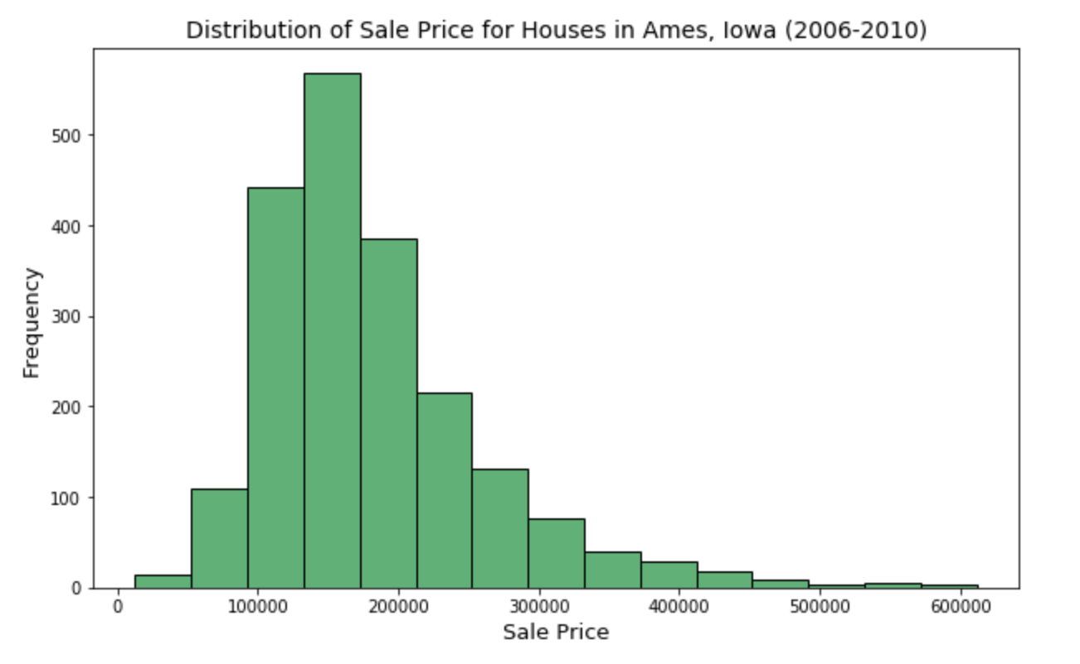
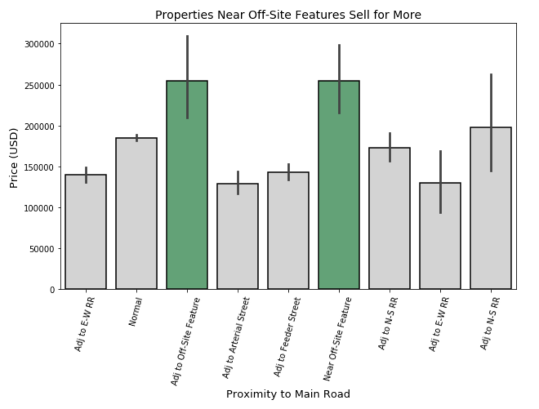
Key Observations from EDA
Clusters can be detected in categorical features.
Sale Price is not normally distributed.

Slide 5
Modeling and Model Selection
Baseline/Null Model
- Features = 0
- Target: Sale Price
- Predicted the mean
RidgeCV Regression
Features = 305
Target: Sale Price
cv = 5
Best alpha = 599.5
LassoCV Regression
Features = 124
Target: Sale Price
cv = 5
Best alpha = 533.7
Linear Regression
Features = 46
Target: log(SalePrice)
Model | Training R2 | Testing R2
Null Model | 0% | 0%
Ridge | 90.2% | 82.3%
LASSO | 91.5% | 80.7%
Linear Regression | 87.4% | 87.8%

Slide 6
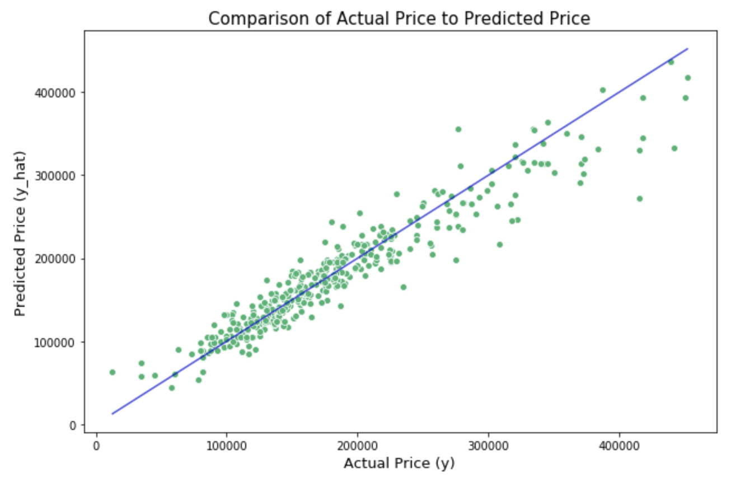
Model Evaluation

Slide 7
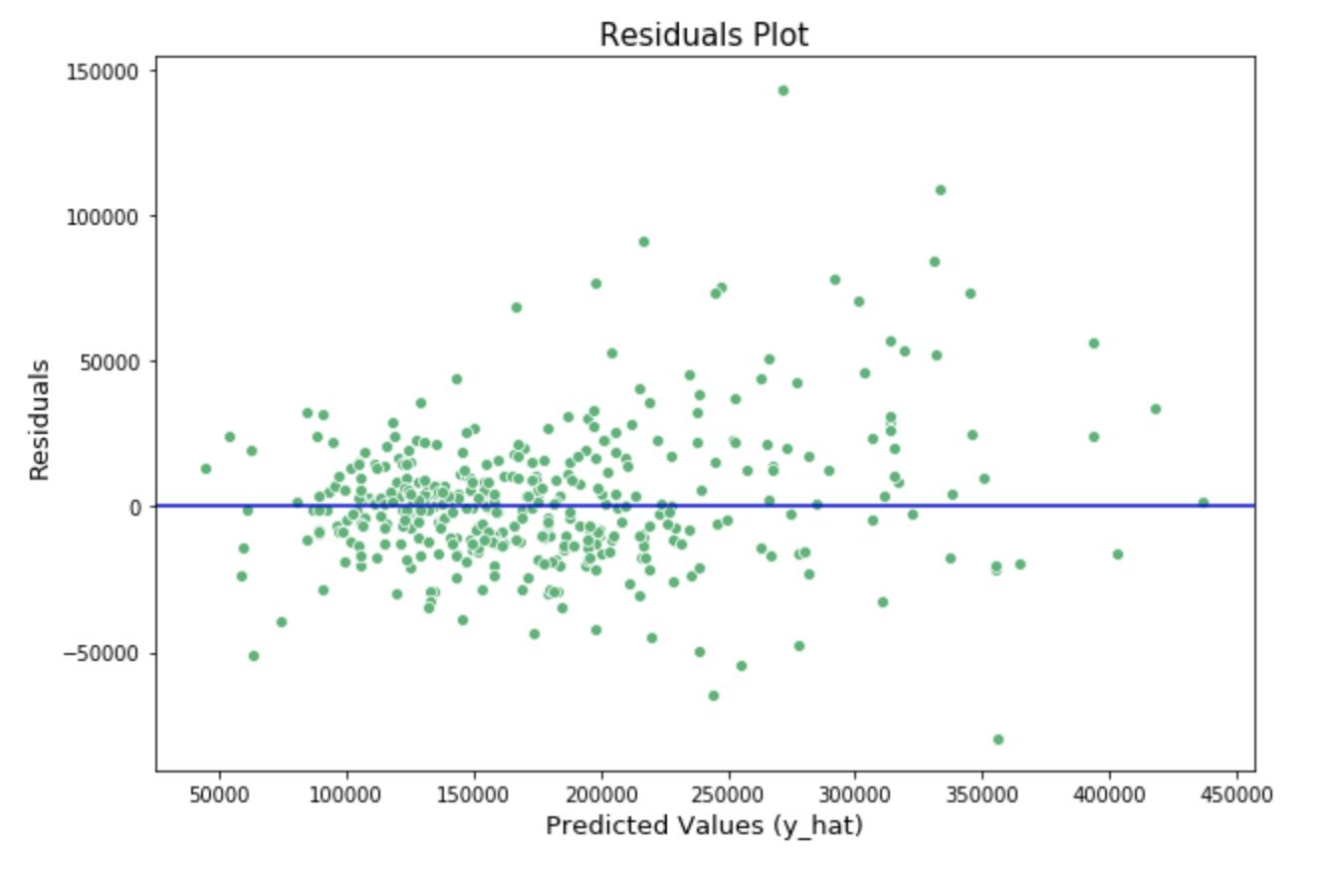
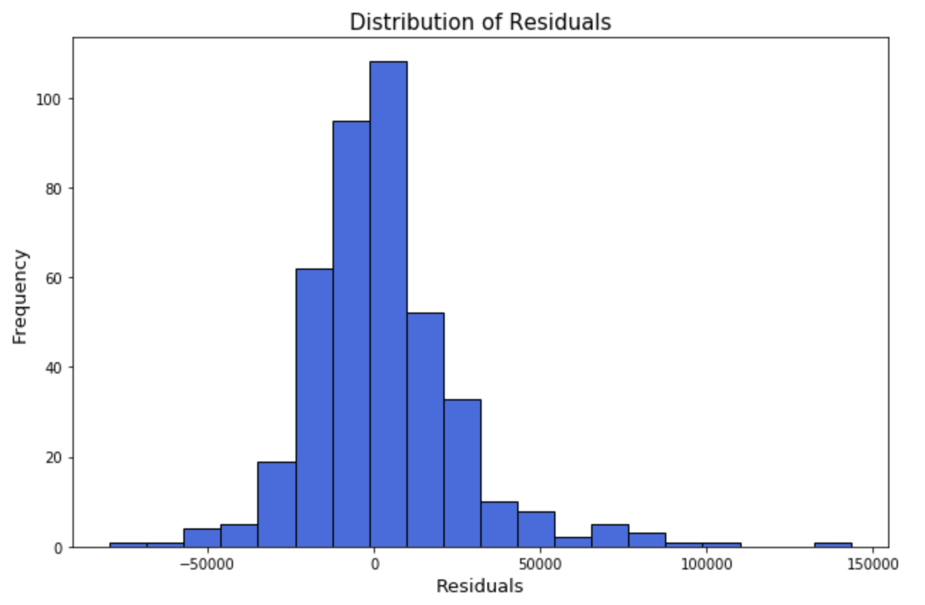
Evaluation of Residuals
Residuals do not show equality of variances or a normal distribution.

Slide 8
Conclusions
For each prediction made with this model, it is likely off by $23,673.28.
This model appears to perform best when having to predict houses within the range of $90,000 – $225,000.
Key Features: Paved Access (19.7%), Exterior Quality – Fair (-17%)
Prior to deploying this model, effort should be made to normalize the distributions of features.

